Slide 1
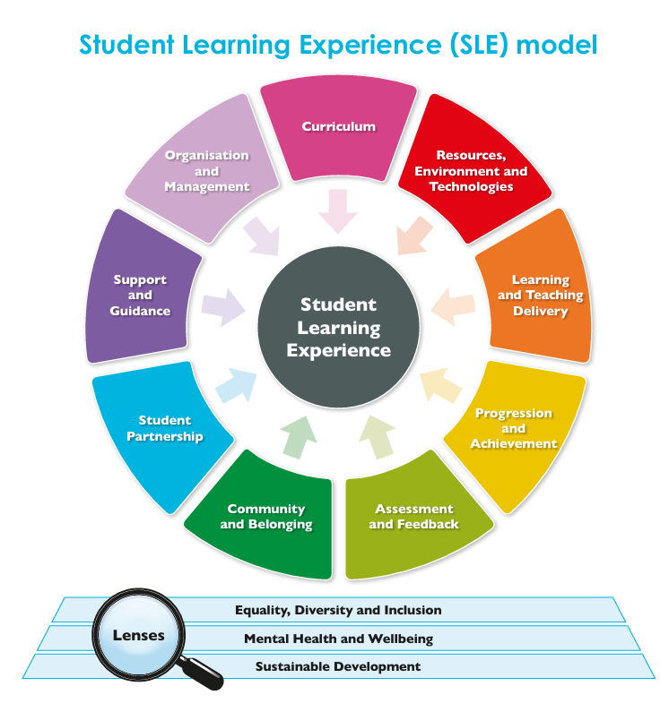
Student Learning Experience (SLE) Model
‘Diamond 9’ Activity Pack

Slide 2
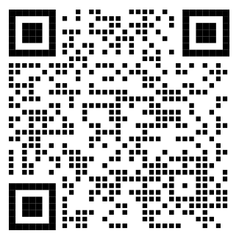
Accessing Core Resource
Hyperlink: Student Learning Experience (SLE) model
QR code:

Slide 3
Building Blocks of the SLE model

Slide 4
Overview
Diamond 9 activities can be used to prompt ranking and discussion within small groups.
Activities are based around arranging 9 cards into a ‘Diamond 9’ shape with:
Most important at top.
Least important at bottom.
Can be used for a variety of purposes, for example:
Identifying priorities for future enhancement.
Celebrating examples of good practice.
Identifying and unpacking differences between staff and students (see slide 6 for example).
1
Most important
2
3
4
5
6
7
8
9
Least important

Slide 5
Instructions: Diamond 9 activity
Work in small groups.
Nominate the following roles and tasks:
Timekeeper: keeps group to time.
Scribe: writes down key discussion points.
Spokesperson: feeds back verbally to wider group.
Ensure that everyone’s voice is heard.
Discuss, rank and arrange your 9 cards into the ‘Diamond 9’ shape shown.
The blank card is intentional – your group can add your own category to this if desired.
1
Most important
2
3
4
5
6
7
8
9
Least important

Slide 6
One example activity: Part 1
Purpose: To identify, compare, and discuss student and staff priorities for enhancement of a unit, course or module
Plenary:
Outline the overall purpose of the session.
Explain instructions for undertaking a Diamond 9 activity.
Round 1:
Divide into small groups (3-4) of either students or staff.
Complete the Diamond 9 activity.
Record this on a Diamond 9 recording sheet.
1
Most important
2
3
4
5
6
7
8
9
Least important
This activity is continued on slide 6

Slide 7
One example activity: Part 2
Round 2:
Ask 1 or 2 members of each group to rotate to another group.
Staff should move to a student group, and vice versa.
Groups should now include a mixture of students and staff.
Repeat the Diamond 9 activity, revising the original Diamond 9 (if appropriate) in response to group discussion.
Record this on a new Diamond 9 recording sheet.
Plenary:
Feed back to wider group: any changes made to Diamond 9 and key related discussion points.
1
Card
Most important
Most important
Card
2
Card
3
Card
4
Card
6
Card
5
Card
7
Card
8
Card
9
Least important

Slide 8
Diamond 9 cards (for ‘on campus’ or ‘online’ activities)

Slide 9
Instructions: Cards for ‘on campus’ activities
Use this PowerPoint file to print off A5 sized cards for your Diamond 9 activities:
Load plain card into your printer.
Go to File/Print and then select 2 slides handout (2 slides per page).
Select slides 11-20.
Cut your printouts into individual cards for use within your ‘on campus’ activities.
1
Most important
2
3
4
5
6
7
8
9
Least important

Slide 10
Instructions: Cards for ‘online’ activities
Use this PowerPoint file to save electronic versions of the cards for your online Diamond 9 activities:
Go to File/Save a Copy.
Select jpg format.
Select ‘just this one’ for slides 11-20 of this PowerPoint file.
This will create 10 individual jpg image files (one for each SLE Building Block + a Blank Card).
Upload these 10 images to an electronic white board (e.g. Padlet) which will allow colleagues to sort them into a Diamond 9 formation.
1
Most important
2
3
4
5
6
7
8
9
Least important

Slide 11

Curriculum
Course content; course design and development; optional and compulsory modules; learning outcomes; placements; study abroad opportunities; inclusive curriculum; sustainability in the curriculum.

Slide 12

Resources, Environment and Technologies
Library; IT; Virtual Learning Environment (VLE); learning spaces; course resources; digital technologies such as equipment and software; external learning environments; study spaces.

Slide 13

Learning and Teaching Delivery
Teaching methods; mode of study; independent and group work; contact time; class sizes; staff development; inclusive learning and teaching practices; peer learning.

Slide 14

Progression and Achievement
Induction; support between levels of study; individual academic progress; personal and professional development; employability; transitions to further study; articulation; recognition of achievement.

Slide 15

Community and Belonging
Learning community; social opportunities; peer support; sense of belonging; community spaces; inclusive communities; student-led communities; local community engagement.

Slide 16

Assessment and Feedback
Assessment methods; frequency of assessments; marking criteria; consistency of marking; formative assessment and feedback; authentic assessment; quality and timeliness of feedback; assessment and feedback support.

Slide 17

Student Partnership
Student representation system; student partnership in decision making; students’ association; course evaluations; student surveys; student voice policies; student engagement in quality processes; hearing diverse student voices; student-led projects and initiatives.

Slide 18

Support and Guidance
Academic support; personal support; disability services; mental health and wellbeing services; support for diverse student groups; financial support; support for students with additional needs for learning.

Slide 19

Organisation and Management
Admissions processes; communication; timetabling; student administration; governance; transport; accommodation; complaints and concerns; equality, diversity and inclusion processes and policies; equality monitoring.

Slide 20
Blank card
A space to add your own ‘Building Block’ for the Student Learning Experience (if you wish):

